Slide 1

DEEP LEARNING SYSTEM FOR MULTIMODAL DOCUMENT UNDERSTANDING AND MANIPULATION​
Team Members:
Saravana Priyan S T | 927623BAD100
Sardheesh M | 927623BAD101
VENKAT RAGAV N | 927623BAD123
Vishnu V | 927623BAD125
GUIDE NAME : Ms.C.BAVITHRA

Slide 2
PROBLEM STATEMENT
Modern digital documents contain diverse and interrelated information in the form of text, tables, images, charts, signatures, and complex layouts. Existing document processing systems often handle these elements independently, making it difficult to understand the document as a complete entity and perform context-aware operations on it. Furthermore, document manipulation tasks such as editing content, modifying formatting, reorganizing information, inserting or removing elements, and generating new content generally require separate tools or manual effort. This creates a gap between document understanding and document manipulation. Therefore, there is a need for an intelligent document processing framework that can interpret the semantic, structural, and visual characteristics of a document and use this understanding to perform appropriate analysis, retrieval, generation, and editing operations while preserving the document's structure and consistency.

Slide 3
OBJECTIVES
To develop an intelligent framework for comprehensive document understanding by analyzing textual, structural, visual, and spatial information present in digital documents.
To establish a unified representation of document content and structure that captures relationships between text, tables, visual elements, and their positions within the document.
To enable context-aware information extraction and reasoning from complex documents and support natural-language interaction with their contents.
To develop intelligent document manipulation capabilities for operations such as editing, formatting, insertion, deletion, rearrangement, and content generation based on user instructions.
To maintain document consistency and structural integrity while performing automated modifications and transformations.
To evaluate the framework based on its document understanding accuracy, manipulation accuracy, structural preservation, and overall usability.

Slide 4
LITERATURE SURVEY
Sl. No. | Title of the Paper | Authors | Journal / Conference | Year | Problem Identified | Solution
4 | Is Cognition Consistent with Perception? Assessing and Mitigating Multimodal Knowledge Conflicts in Document Understanding | Zirui Shao et al. | EMNLP | 2025 | Multimodal LLMs can generate answers inconsistent with what they visually perceive in documents. | Defines cognition–perception conflicts and proposes multimodal knowledge-consistency fine-tuning to improve consistency.
5 | WikiMixQA: A Multimodal Benchmark for Question Answering over Tables and Charts | Negar Foroutan et al. | Findings of ACL | 2025 | Models struggle with questions requiring joint reasoning over tables and charts, especially with long-document retrieval. | Introduces a benchmark containing cross-modal table/chart questions and evaluates multiple VLMs under direct and retrieval-based settings.
6 | ColPali: Efficient Document Retrieval with Vision Language Models | Manuel Faysse et al. | ICLR | 2025 | OCR/text-based retrieval loses visual information such as tables, figures, layout and fonts. | Directly embeds document-page images using a vision-language model and multi-vector late-interaction retrieval.

Slide 5
LITERATURE SURVEY
Sl. No. | Title of the Paper | Authors | Journal / Conference | Year | Problem Identified | Solution
1 | Scaling Beyond Context: A Survey of Multimodal Retrieval-Augmented Generation for Document Understanding | Sensen Gao et al. | ACL | 2026 | OCR-based systems lose visual/structural information, while MLLMs struggle with long multimodal documents. | Surveys multimodal RAG approaches using fine-grained representations and multimodal retrieval; identifies efficiency, robustness and fine-grained representation as open challenges.
2 | M-LongDoc: A Benchmark for Multimodal Super-Long Document Understanding and a Retrieval-Aware Tuning Framework | Yew Ken Chia et al. | EMNLP | 2025 | MLLMs struggle with very long documents containing text, figures and tables and retrieving the correct evidence. | Introduces an 851-sample benchmark and a retrieval-aware tuning framework for long multimodal documents.
3 | MMDocIR: Benchmarking Multimodal Retrieval for Long Documents | Kuicai Dong et al. | EMNLP | 2025 | Existing retrieval benchmarks inadequately evaluate multimodal elements such as figures, tables and fine-grained layouts. | Introduces page-level and layout-level multimodal retrieval benchmarks and evaluates visual/document retrieval methods.

Slide 6
LITERATURE SURVEY
Sl. No. | Title of the Paper | Authors | Journal / Conference | Year | Problem Identified | Solution
7 | DocEdit-v2: Document Structure Editing Via Multimodal LLM Grounding | Manan Suri et al. | EMNLP | 2024 | Natural-language document editing requires identifying the correct document region and accurately interpreting the requested structural operation. | Uses multimodal LLM grounding with region localization, command generation and command reformulation for document editing.
8 | Pix2Struct: Screenshot Parsing as Pretraining for Visual Language Understanding | Kenton Lee et al. | ICML | 2023 | Visually situated information such as documents, webpages and tables is difficult to represent using conventional text-centric approaches. | Pretrains an image-to-text model through screenshot parsing into simplified HTML for visual-language understanding.
9 | DePlot: One-shot Visual Language Reasoning by Plot-to-Table Translation | Fangyu Liu et al. | Findings of ACL | 2023 | Direct reasoning over charts is difficult and often requires task-specific training. | Converts chart images into structured/linearized tables and uses an LLM for downstream reasoning.

Slide 7
EXISTING SYSTEM
OCR-based document processing extracts text from scanned documents but often loses layout, visual and semantic relationships.
Layout-aware models such as LayoutLM, DocFormer and UDOP combine text, visual and positional information for document understanding.
Modern VLMs/MLLMs such as Qwen-VL can understand text, tables, images, charts and document layouts directly from visual inputs.
Multimodal retrieval systems such as ColPali enable retrieval from visually rich document pages.
Document editing systems such as DocEdit and DocEdit-v2 can convert natural-language instructions into document editing operations.
However, these capabilities are largely addressed as separate tasks, with limitations in cross-modal reasoning, structural grounding and reliable manipulation.

Slide 8
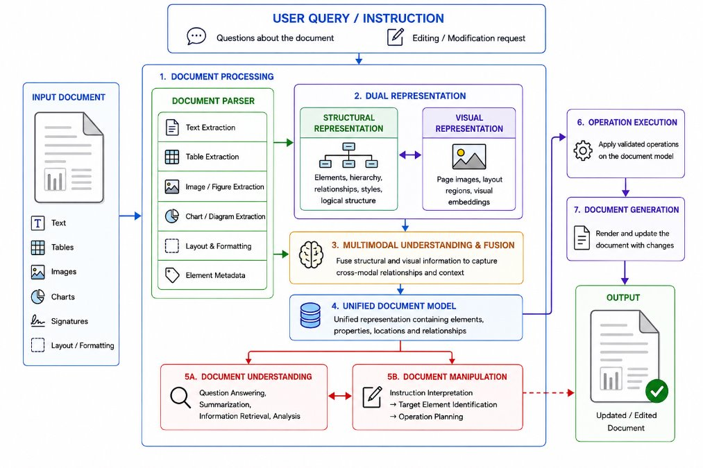
PROPOSED ARCHITECTURE

Slide 9
RESEARCH GAP
Fragmented modality processing: Existing systems often specialize in text, tables, charts, images, or layout rather than providing reliable joint understanding across all document elements.
Weak cross-modal reasoning: Current VLM/MLLM systems still struggle to establish relationships between text ↔ tables ↔ charts ↔ images ↔ layout and detect inconsistencies between them.
Limited structural grounding: Visual models understand document appearance but may lack access to the exact editable document structure, styles, and object identities.
Retrieval limitations: Multimodal RAG improves access to visual evidence, but fine-grained, structure-aware retrieval and evidence grounding remain challenging for long documents.
Understanding–manipulation disconnect: Existing document-editing approaches focus on generating edits, but reliable manipulation requires accurately understanding and grounding the user's instruction to the correct document element.

Slide 10
PROPOSED SYSTEM
Document Parsing: Extract text, tables, images, charts, signatures, formatting and layout information from heterogeneous documents.
Dual Representation: Maintain both structural and visual representations of the document.
Multimodal Understanding: Apply deep learning models specialized for textual and visual document content.
Cross-Modal Fusion: Combine information across modalities to identify semantic, contextual and spatial relationships.
Unified Document Representation: Represent document elements along with their properties, locations and relationships.
Intelligent Understanding: Support document question answering, analysis, information retrieval and evidence-based reasoning.
Grounded Manipulation: Convert natural-language instructions into structured document operations, identify the correct target elements, validate the operation and apply the modification.

Slide 11
METHODOLOGY AND MODULES
Document Input & Parsing: Process heterogeneous documents and extract text, tables, images, charts, signatures, layout and formatting information.
Dual Representation : Create complementary structural and visual representations while preserving element locations and metadata.
Multimodal Understanding : Encode textual and visual information and perform cross-modal fusion to capture semantic and spatial relationships.
Unified Document Modeling : Construct a structured representation of document elements, their properties and relationships.
Document Understanding : Perform question answering, information retrieval, summarization, analysis and cross-modal reasoning.
Document Manipulation : Interpret natural-language instructions, identify the target element, generate a structured operation and apply validated changes.

Slide 12
METHODOLOGY AND MODULES
Module | Main Function
Document Parser | Extract document content and structure
Structural Representation | Represent text, tables, layout, styles and relationships
Visual Representation | Represent page visuals, charts, images and signatures
Multimodal Fusion | Combine information across modalities
Unified Document Model | Maintain elements, properties, locations and relationships
Understanding Module | QA, retrieval, summarization and analysis
Manipulation Module | Instruction interpretation and operation planning
Validation & Execution | Verify and apply document modifications

